Slide 1
PDAT613G: Data Mining
Module 2A – Supervised Learning, Part 2

Slide 2
Tree-Based Predictors (CART)

Slide 3
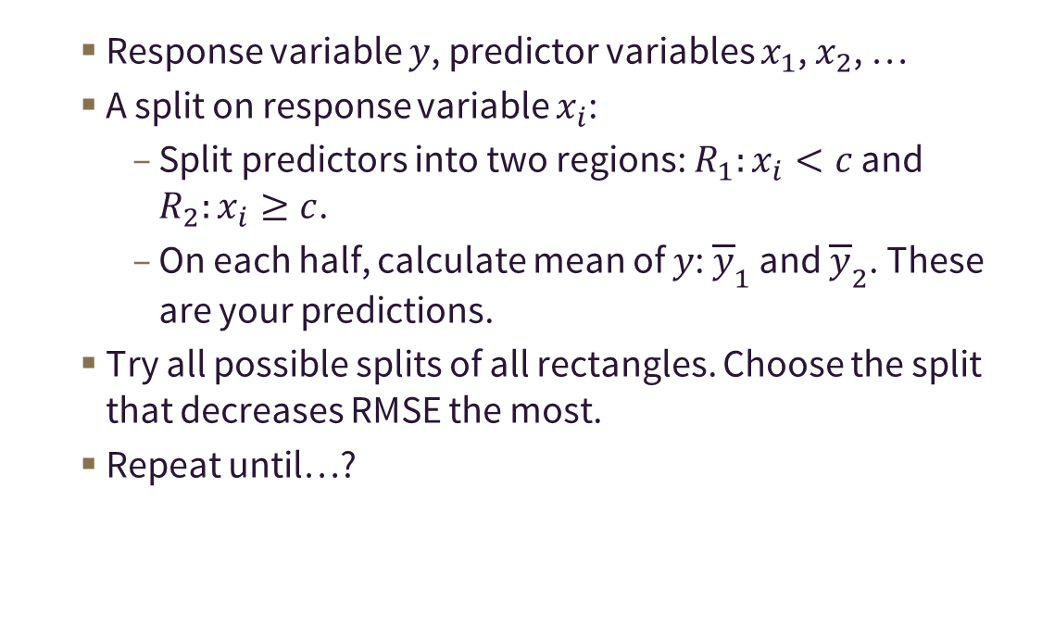
47 – Tree-based methods split the range of the x’s into rectangles, then predict on each rectangle.
Response variable $y$, predictor variables $x_{1}$, $x_{2}$, …
A split on response variable $x_{i}$:
Split predictors into two regions: $R_{1}:x_{i}<c$ and $R_{2}:x_{i}≥c$.
On each half, calculate mean of $y$: ${\overline{y}}_{1}$ and ${\overline{y}}_{2}$. These are your predictions.
Try all possible splits of all rectangles. Choose the split that decreases RMSE the most.
Repeat until…?

Slide 4
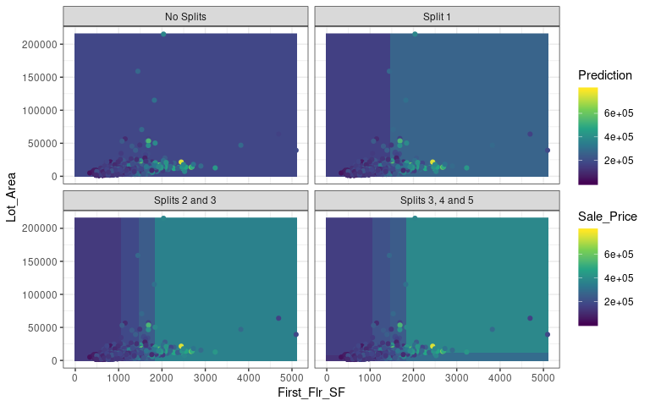
48 – The first several splits predicting Sale Price with First Floor Square Footage and Lot Area.
Notes:
Here’s a visualization of the process of creating a tree-based predictor for home sale price.
First, all possible splits of the entire range of predictors are considered, and it’s found that the best split happens at SF = 1453. If SF < 1453, then we end up predicting home sale price is about $157,000. If SF >= 1453, then we end of predicting home sale price is about $265,000. (Those numbers come from the next slide.) All of this is reflected in the upper-right graph.
Next, we consider all possible splits of the dark blue rectangle on the left, and all possible splits of the lighter blue rectangle on the right. This results in another split based on square footage. Then all possible splits of the three resulting rectangles are considered, and another split by SF is the best possible split. This stage of the algorithm is represented in the lower-left graph.
You can see that we’re getting a more fine-grained predictor as we go, and the splits are indicating that square footage is a bit more important at the early stages, when trying to predict sale price. This is consistent with what we saw in our linear regression predictor. The color gradient for the linear regression predictor changed more strongly in the horizontal direction than the vertical direction.
The last set of splits, which I believe should actually be labeled 4, 5 and 6, finally see some advantage to splitting by lot area. It’s a bit harder to see them in the lower-right graph, but if you look closely, you’ll see that the the left-most rectangle has been split close to the bottom of the graph, the second-to-the-left rectange has been split (almost covered up by data points), and the right-hand rectangle has been split (which is the one easiest to see).
I hope you can see at this point that this sort of predictor offers the advantage of flexibility, compared to a regression model. It’s possible to model non-linear relationships, and pick out particular regions where the response variable might take on diffrent values, for whatever the reason. While it might seem that a predictor that takes on constant values on a big rectangular region would be less accurate than a regression model, it often turns out to be the case that these tree-based predictors can give good results. The key is to pick sensible choices of the complexity parameter (and other model-building parameters) that keep the flexibility of the model from leading to too much overfitting.

Slide 5
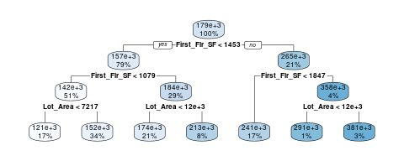
49 – These models can be represented as step-by-step decision trees—often called CART models.
In R, rpart can be used to create these decision trees.
The rpart.plot library and command can graph the trees.
library(rpart) library(rpart.plot) ames2.rpart <- rpart(Sale_Price ~ ., data=ames2.train) rpart.plot(rpart(Sale_Price ~ ., data=ames2.train))

Slide 6
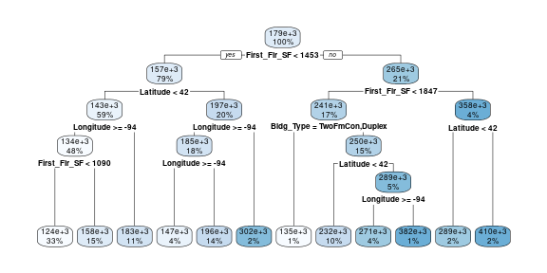
50 – In a six-variable CART model, note that Square Footage, Latitude and Longitude are important!
ames6.rpart <- rpart(Sale_Price ~ ., data=ames6.train) rpart.plot(ames6.rpart)

Slide 7
51 – For non-linear variable relationships, CART models can sometimes do better than regression.
ames6.test.rpart.pred <- predict(ames6.rpart, newdata=ames6.test) # The regression model. RMSE(ames6.test$Sale_Price, ames6.test.lm.pred)
[1] 59925
# The CART model. RMSE(ames6.test$Sale_Price, ames6.test.rpart.pred)
[1] 52826

Slide 8
Random Forests

Slide 9
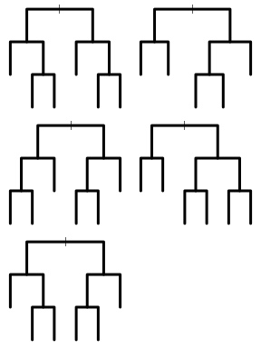
52 – Random forests average the predictions of multiple trees, often producing a better predictor.
Averaging results from multiple models can often achieve better predictions, but only if those models are not structurally the same:
Multiple bootstrap samples are taken from the original training data.
A decision tree is produced from each bootstrap sample.
Possible splitting variables at each node of each decision tree are randomly determined.

Slide 10
53 – Bootstrap sampling uses a single data set to simulate variability in a whole population.
Principle: The original sample is the best representation we have of the unknown population.
Sample with replacement from the original sample to get many more samples of the same sample size. (Some data points will be sampled more than once, some not at all.)
Averaging predictors created from different bootstrap samples can help create a predictor with less variance than a single tree.
orig.x | orig.y | boot.x | boot.y
1 | 3 | 1 | 3
2 | 7 | 2 | 7
3 | 11 | 2 | 7
4 | 12 | 3 | 11
5 | 14 | 4 | 12
6 | 13 | 6 | 13
7 | 15 | 8 | 19
8 | 19 | 8 | 19
9 | 21 | 9 | 21
10 | 22 | 9 | 21

Slide 11
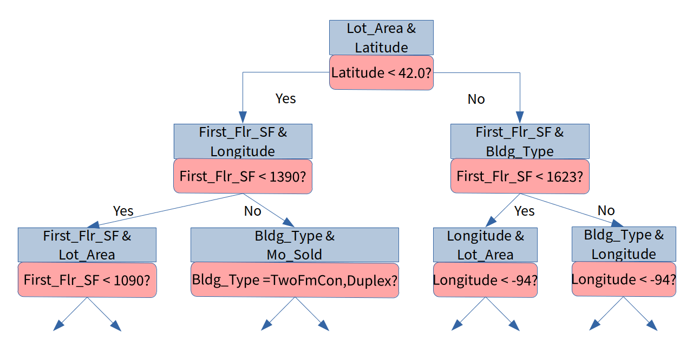
54 – Randomization of possible splitting variables at each node helps create varying trees.

Slide 12
55 – In this case, a random forest model does better than a single CART model.
library(randomForest)
ames6.rf <- randomForest(Sale_Price ~ ., data=ames6.train) ames6.test.rf.pred <- predict(ames6.rf, newdata=ames6.test) # The regression model. RMSE(ames6.test$Sale_Price, ames6.test.lm.pred)
[1] 59925
# The CART model. RMSE(ames6.test$Sale_Price, ames6.test.rpart.pred)
[1] 52826
# The random forest model. RMSE(ames6.test$Sale_Price, ames6.test.rf.pred)
[1] 42253

Slide 13
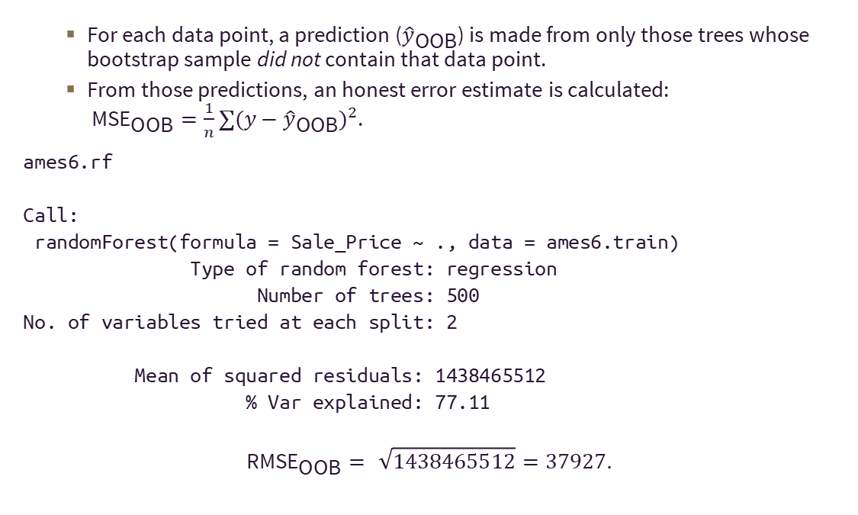
56 – Random forests come with a built-in measure of accuracy: Out-of-bag Error.
For each data point, a prediction (${\hat{y}}_{\text{OOB}}$) is made from only those trees whose bootstrap sample did not contain that data point.
From those predictions, an honest error estimate is calculated: ${\text{MSE}}_{\text{OOB}}=\frac{1}{n}∑(y−{\hat{y}}_{\text{OOB}})^{2}$.
ames6.rf
Call: randomForest(formula = Sale_Price ~ ., data = ames6.train) Type of random forest: regression Number of trees: 500 No. of variables tried at each split: 2 Mean of squared residuals: 1438465512 % Var explained: 77.11
$${\text{RMSE}}_{\text{OOB}}=\sqrt{1438465512}=37927.$$

Slide 14
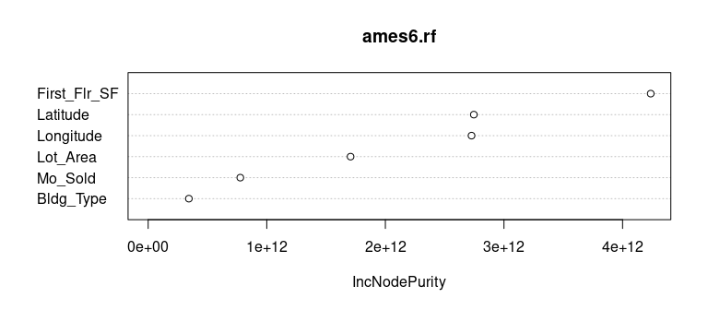
57 – A random forest is a bit of a “black box,” but you can get a measure of variable importance.
On average, over all the trees in the forest, how much did each variable decrease the sum of squared error of the prediction?
# Or, use imporance(ames6.rf) for text output. varImpPlot(ames6.rf)

Slide 15
58 – Most modeling algorithms have “tuning parameters” that must be set.
Increased complexity can lead to a better fit, but may also lead to overfitting!
Linear regression: Which variables are included/excluded.
CART: Tree complexity. (When should we stop splitting the tree?)
Random Forests: Tree complexity, number of trees.
Model tuning is about finding the right balance for the data you’re studying.

Slide 16
59 – Question
Consider the random forest model created by the commands below (caution, they may take some time to run yourself, but they should run!). What’s wrong with this attempted analysis?
ames.full <- make_ames() ames.full.rf <- randomForest(Sale_Price ~ ., data=ames.full) RMSE(ames.full$Sale_Price, predict(ames.full.rf, newdata=ames.full))
[1] 10011
The full Ames data set has categorical variables, and random forests don’t like categorical variables.
It calculates RMSE for the model using the original training set, which over-estimates the model’s error.
It calculates RMSE for the model using the original training set, which under-estimates the model’s error.
There’s no model tuning step. Model tuning might give an even more accurate model.

Slide 17
Classification

Slide 18
60 – Classification
Classification tries to predict how each observation can be sorted into one of several categories.
Classification can be used to predict whether a potential customer is likely to become an actual customer, or whether an individual is likely to vote for a particular candidate or even vote at all.
Classification can also be used for more immediate tasks, like identifying whether or not an incoming message is identified as spam.
A classification model is a set of rules that could be used to make these predictions.
Regression predicts a number; classification predicts a category.

Slide 19
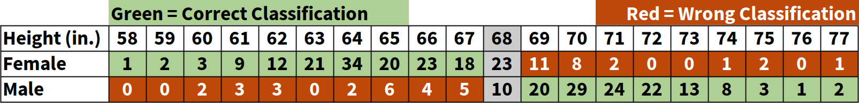
61 – Predicting Gender just from Height
348 college students were asked to report height and gender.
Can we guess gender from height?
Look at all individuals shorter than 67 inches.
Look at all individuals taller than 69 inches.
What about individuals who are 68 inches?
Classification Rule: Anyone 68 inches or shorter is assumed to be female.
In practice, predicting gender is problematic. Why?

Slide 20
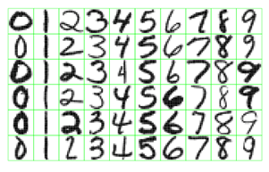
62 – Handwriting Recognition

Slide 21
63 – Classification
In this program, we will focus on the following classification techniques:
Decision Trees (CART=Classification and Regression Trees)
Random Forests
Logistic Regression
Support Vector Machines (SVM)
Many techniques used for classification can ALSO be used for Regression.

Slide 22
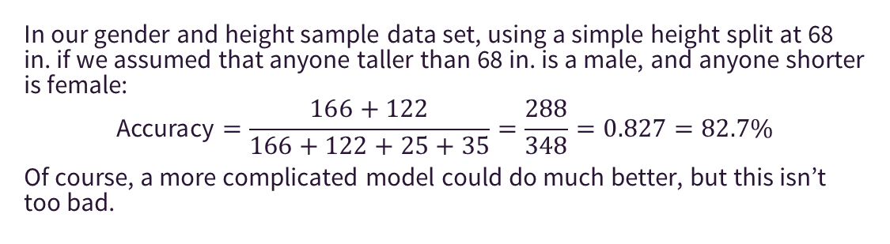
64 – Confusion Matrix
A confusion matrix summarizes the results of a classification algorithm.
True Positives
True Negatives
False Positives
False Negatives
 | 68" or Shorter | Taller than 68"
F | 166 | 25
M | 35 | 122
In our gender and height sample data set, using a simple height split at 68 in. if we assumed that anyone taller than 68 in. is a male, and anyone shorter is female:
$$\text{Accuracy}=\frac{166+122}{166+122+25+35}=\frac{288}{348}=0.827=82.7\%$$
Of course, a more complicated model could do much better, but this isn’t too bad.

Slide 23
65 – Question
Besides Accuracy, we sometimes are interested in the proportion of positives that are correctly identified (Sensitivity) and proportion of negatives that are correctly identified (Specificity).
Sensitivity = #(actually pos and detected pos)/#(actually pos)
Specificity = #(actually neg and detected neg)/(actually #neg)
 | 68" or Shorter | Taller than 68"
F | 166 | 25
M | 35 | 122
If we model that all respondents 68" or shorter are predicted to be female, what is our Sensitivity? (It should be a number between 0 and 1.)

Slide 24
Tree-Based Classification Methods

Slide 25
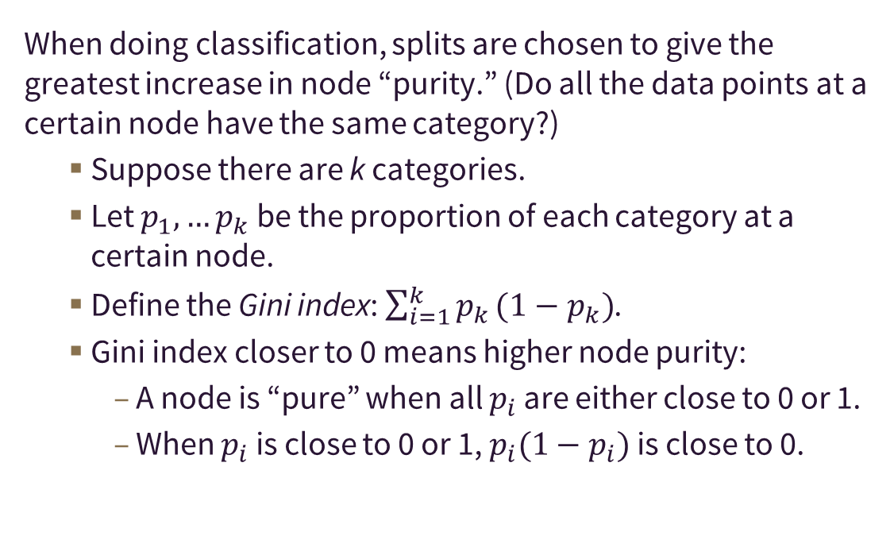
66 – CART models can be used for classification as well. (It’s in the name!)
When doing classification, splits are chosen to give the greatest increase in node “purity.” (Do all the data points at a certain node have the same category?)
Suppose there are k categories.
Let $p_{1},…p_{k}$ be the proportion of each category at a certain node.
Define the Gini index: $\sum_{i=1}^{k}{p_{k}}(1−p_{k})$.
Gini index closer to 0 means higher node purity:
A node is “pure” when all $p_{i}$ are either close to 0 or 1.
When $p_{i}$ is close to 0 or 1, $p_{i}(1−p_{i})$ is close to 0.

Slide 26
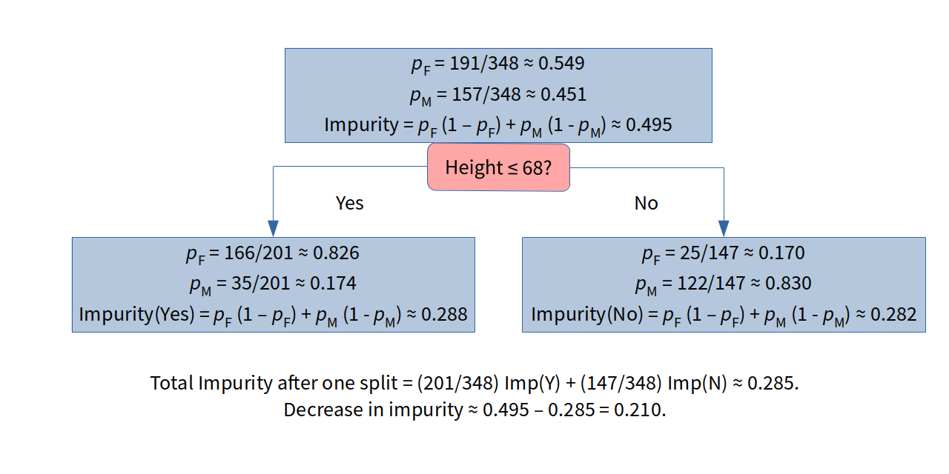
67 – Example: Height and Gender

Slide 27
68 – Example: Predicting Heart Disease
As a simple example, can we use two variables to predict whether a patient will be diagnosed with heart disease?
thalach: Related to the maximum heart rate achieved during exercise.
oldpeak: Related to a comparison of part of the electrocardiogram signal (ST depression) while resting and after exercise.
num: Number of major vessels with > 50% diameter narrowing. Any number greater than 0 represents heart disease.
Data made available through the UCI Machine Learning Repository and gathered by Andras Janosi, M.D.; William Steinbrunn, M.D.; Matthias Pfisterer, M.D.; and Robert Detrano, M.D., Ph.D.

Slide 28
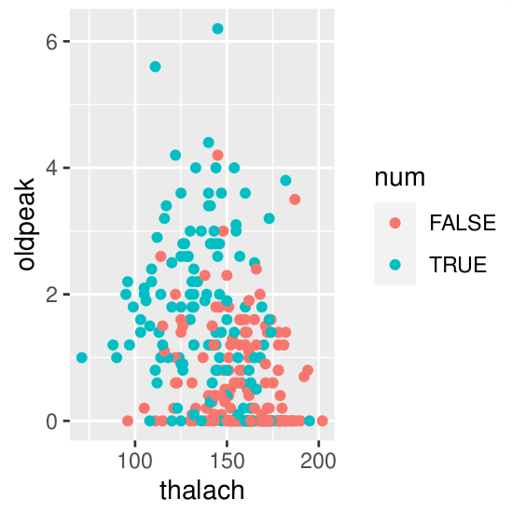
69 – The data needs some preparation. These two variables appear to have some predictive power.
heart <- read.csv("data/processed.cleveland.data", header=FALSE, na.strings="?") names(heart) <- c("age", "sex", "cp", "trestbps", "chol", "fbs", "restecg", "thalach", "exang", "oldpeak", "slope", "ca", "thal", "num") heart$num <- factor(heart$num > 0) heart <- heart %>% select(thalach, oldpeak, num) set.seed(432) samp_ind <- sample(1:nrow(heart), floor(0.70*nrow(heart))) heart.train <- heart[samp_ind, ] heart.test <- heart[-samp_ind, ]
ggplot(heart) + geom_point(aes(x=thalach, y=oldpeak, color=num))

Slide 29
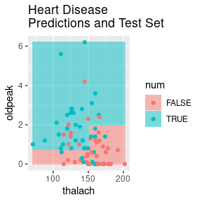
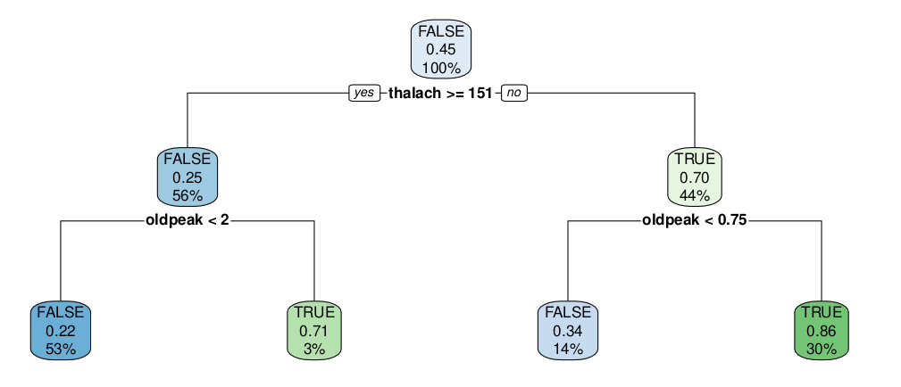
70 – This CART model highlights two main regions in the parameter space.
heart.rpart <- rpart(num ~ ., data=heart.train) rpart.plot(heart.rpart)

Slide 30
71 – A confusion matrix shows that this model predicts better than the “no information” rate.
heart.pred.rpart <- predict(heart.rpart, newdata=heart.test, type="class") # The `caret` package gives the confusionMatrix command. # Predictions first, then true values. confusionMatrix(heart.pred.rpart, heart.test$num, pos="TRUE")
Confusion Matrix and Statistics Reference Prediction FALSE TRUE FALSE 37 16 TRUE 10 28 Accuracy : 0.714 95% CI : (0.61, 0.804) No Information Rate : 0.516 P-Value [Acc > NIR] : 9.53e-05 Kappa : 0.425 Mcnemar's Test P-Value : 0.327 Sensitivity : 0.636 Specificity : 0.787 Pos Pred Value : 0.737 Neg Pred Value : 0.698 Prevalence : 0.484 Detection Rate : 0.308 Detection Prevalence : 0.418 Balanced Accuracy : 0.712 'Positive' Class : TRUE

Slide 31

72 – A random forest doesn’t do better in this case, primarily due to overfitting the training data.
heart.rf <- randomForest(num ~ ., data=heart.train) heart.pred.rf <- predict(heart.rf, newdata=heart.test) confusionMatrix(heart.pred.rf, heart.test$num, positive="TRUE")
Confusion Matrix and Statistics Reference Prediction FALSE TRUE FALSE 34 19 TRUE 13 25 Accuracy : 0.648 95% CI : (0.541, 0.746) No Information Rate : 0.516 P-Value [Acc > NIR] : 0.00757 Kappa : 0.293 Mcnemar's Test P-Value : 0.37676 Sensitivity : 0.568 Specificity : 0.723 Pos Pred Value : 0.658 Neg Pred Value : 0.642 Prevalence : 0.484 Detection Rate : 0.275 Detection Prevalence : 0.418 Balanced Accuracy : 0.646 'Positive' Class : TRUE

Slide 32
Support Vector Machines

Slide 33
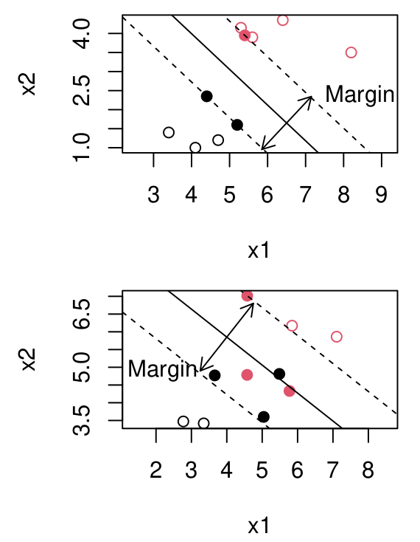
73 – Support vector machines are used for classification (and in rare cases for regression).
Plot each data item as a point in n-dimensional space (where n is the number of features).
Find the hyperplane that “best” separates the classes.
If classes are separable, find the plane that maximizes the margin between classes.
If not separable, maximize the margin, allowing a certain amount of violation.
Support vectors (filled dots) are the points within the margin.

Slide 34
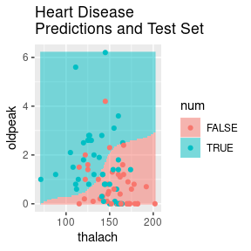
74 – Example: Default svm from the e1071 package.
library(e1071) heart.svm <- svm(num ~ ., data=heart.train) heart.pred.svm <- predict(heart.svm, newdata=heart.test) confusionMatrix(heart.pred.svm, heart.test$num, positive="TRUE")
Confusion Matrix and Statistics Reference Prediction FALSE TRUE FALSE 40 20 TRUE 7 24 Accuracy : 0.703 95% CI : (0.598, 0.795) No Information Rate : 0.516 P-Value [Acc > NIR] : 0.000223 Kappa : 0.4 Mcnemar's Test P-Value : 0.020921 Sensitivity : 0.545 Specificity : 0.851 Pos Pred Value : 0.774 Neg Pred Value : 0.667 Prevalence : 0.484 Detection Rate : 0.264 Detection Prevalence : 0.341 Balanced Accuracy : 0.698 'Positive' Class : TRUE

Slide 35
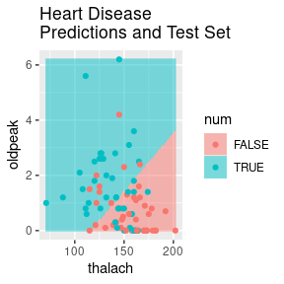
75 – Example: Using the “linear” kernel with svm.
heart.svm <- svm(num ~ ., data=heart.train, kernel="linear") heart.pred.svm <- predict(heart.svm, newdata=heart.test) confusionMatrix(heart.pred.svm, heart.test$num, positive="TRUE")
Confusion Matrix and Statistics Reference Prediction FALSE TRUE FALSE 36 18 TRUE 11 26 Accuracy : 0.681 95% CI : (0.575, 0.775) No Information Rate : 0.516 P-Value [Acc > NIR] : 0.00105 Kappa : 0.359 Mcnemar's Test P-Value : 0.26521 Sensitivity : 0.591 Specificity : 0.766 Pos Pred Value : 0.703 Neg Pred Value : 0.667 Prevalence : 0.484 Detection Rate : 0.286 Detection Prevalence : 0.407 Balanced Accuracy : 0.678 'Positive' Class : TRUE

Slide 36
76 – More on Support Vector Machines
The “Kernel Trick”
SVM isn’t used with the original data, but a “kernel-transformed” version of the data.
The effect is to push the data points up to a higher-dimensional space, allowing easier separation. Often this works.
A common kernel is the radial basis kernel.
Tuning parameters for the model include…
Cost: How much should violations be penalized?
Gamma: For the radial basis kernel, determines “spread” of the kernel. Roughly, how much do far-away points affect classification?
Can be used for classification with more than two categories.

Slide 37
Logistic Regression

Slide 38
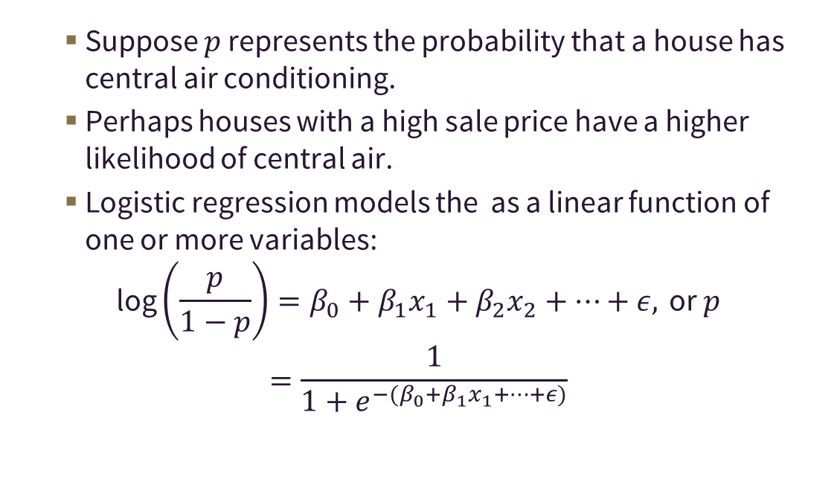
77 – Logistic regression predicts the likelihood of a Yes/No categorical variable.
Suppose $p$ represents the probability that a house has central air conditioning.
Perhaps houses with a high sale price have a higher likelihood of central air.
Logistic regression models the as a linear function of one or more variables:
$$\text{log}\left(\frac{p}{1−p}\right)=β_{0}+β_{1}x_{1}+β_{2}x_{2}+⋯+ε, \text{or} p=\frac{1}{1+e^{−(β_{0}+β_{1}x_{1}+⋯+ε)}}$$

Slide 39
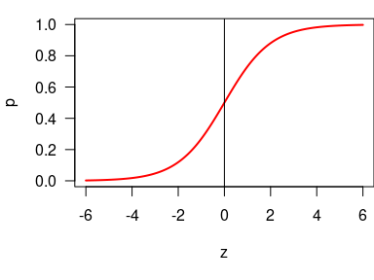
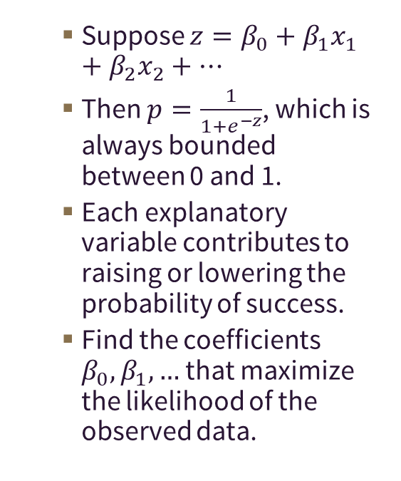
78 – Logistic Function
Suppose $z=β_{0}+β_{1}x_{1}+β_{2}x_{2}+⋯$
Then $p=\frac{1}{1+e^{−z}}$, which is always bounded between 0 and 1.
Each explanatory variable contributes to raising or lowering the probability of success.
Find the coefficients $β_{0},β_{1},…$ that maximize the likelihood of the observed data.

Slide 40
79 – Results of logistic regression can be interpreted much as regular linear regression.
heart.log <- glm(num ~ ., data=heart.train, family="binomial") summary(heart.log)
Call: glm(formula = num ~ ., family = "binomial", data = heart.train) Deviance Residuals: Min 1Q Median 3Q Max -2.187 -0.825 -0.506 0.785 2.295 Coefficients: Estimate Std. Error z value Pr(>|z|) (Intercept) 4.18073 1.25826 3.32 0.00089 *** thalach -0.03456 0.00809 -4.27 1.9e-05 *** oldpeak 0.78989 0.16754 4.71 2.4e-06 *** --- Signif. codes: 0 '***' 0.001 '**' 0.01 '*' 0.05 '.' 0.1 ' ' 1 (Dispersion parameter for binomial family taken to be 1) Null deviance: 291.61 on 211 degrees of freedom Residual deviance: 223.51 on 209 degrees of freedom AIC: 229.5 Number of Fisher Scoring iterations: 4

Slide 41
80 – Conclusions from the logistic regression model.
Both thalach and oldpeak have a statistically significant relationship to heart disease.
Increases in thalach are related to lower odds of heart disease.
Increases in oldpeak are related to higher odds of heart disease.

Slide 42
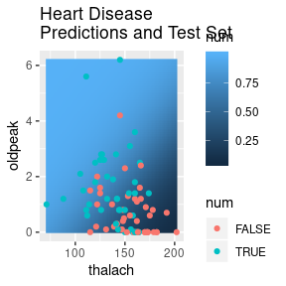
81 – Example: Heart Disease
Note that logistic regression, on its own, gives a continuous predictor of the probability of success, not a yes/no prediction.

Slide 43
82 – Logistic regression can also be used for prediction.
Pick a cut-off probability for what constitutes a “success.”
Choosing this cut-off probability is not cut-and-dried.
Minimize false positives?
Minimize false negatives?
Minimize overall misclassification?
Cutoff is a tuning parameter if you use the model for classification.
If success and failure are approximately equally represented in the data, a 50% cutoff might be a good starting point.

Slide 44

83 – Example: Heart Disease
heart.pred.log <- predict(heart.log, newdata=heart.test, type="response") heart.pred.log <- factor(heart.pred.log >= 0.50) confusionMatrix(heart.pred.log, heart.test$num, positive="TRUE")
Confusion Matrix and Statistics Reference Prediction FALSE TRUE FALSE 36 17 TRUE 11 27 Accuracy : 0.692 95% CI : (0.587, 0.785) No Information Rate : 0.516 P-Value [Acc > NIR] : 0.000495 Kappa : 0.381 Mcnemar's Test P-Value : 0.344704 Sensitivity : 0.614 Specificity : 0.766 Pos Pred Value : 0.711 Neg Pred Value : 0.679 Prevalence : 0.484 Detection Rate : 0.297 Detection Prevalence : 0.418 Balanced Accuracy : 0.690 'Positive' Class : TRUE

Slide 45
84 – Question
The CART model, SVM machine models and logistic regression models all have accuracy in predicting heart disease that’s close to 70%. Models may differ in other ways that are important, however. In a medical test, we might care about sensivity–ability to detect people who actually have heart disease. Which of the heart disease models has the lowest sensitivity?

Slide 46
85 – Question
Which of the following is not a classification algorithm?
Support vector machines
Linear regression
Decision trees
Random forests

Slide 47
86 – Conclusion: Supervised Models
This module has provided an introduction to several kinds of supervised data mining models:
Multiple Regression
Decision Trees (CART)
Random Forests
Logistic Regression
Support Vector Machines (SVM)

